Slide 1
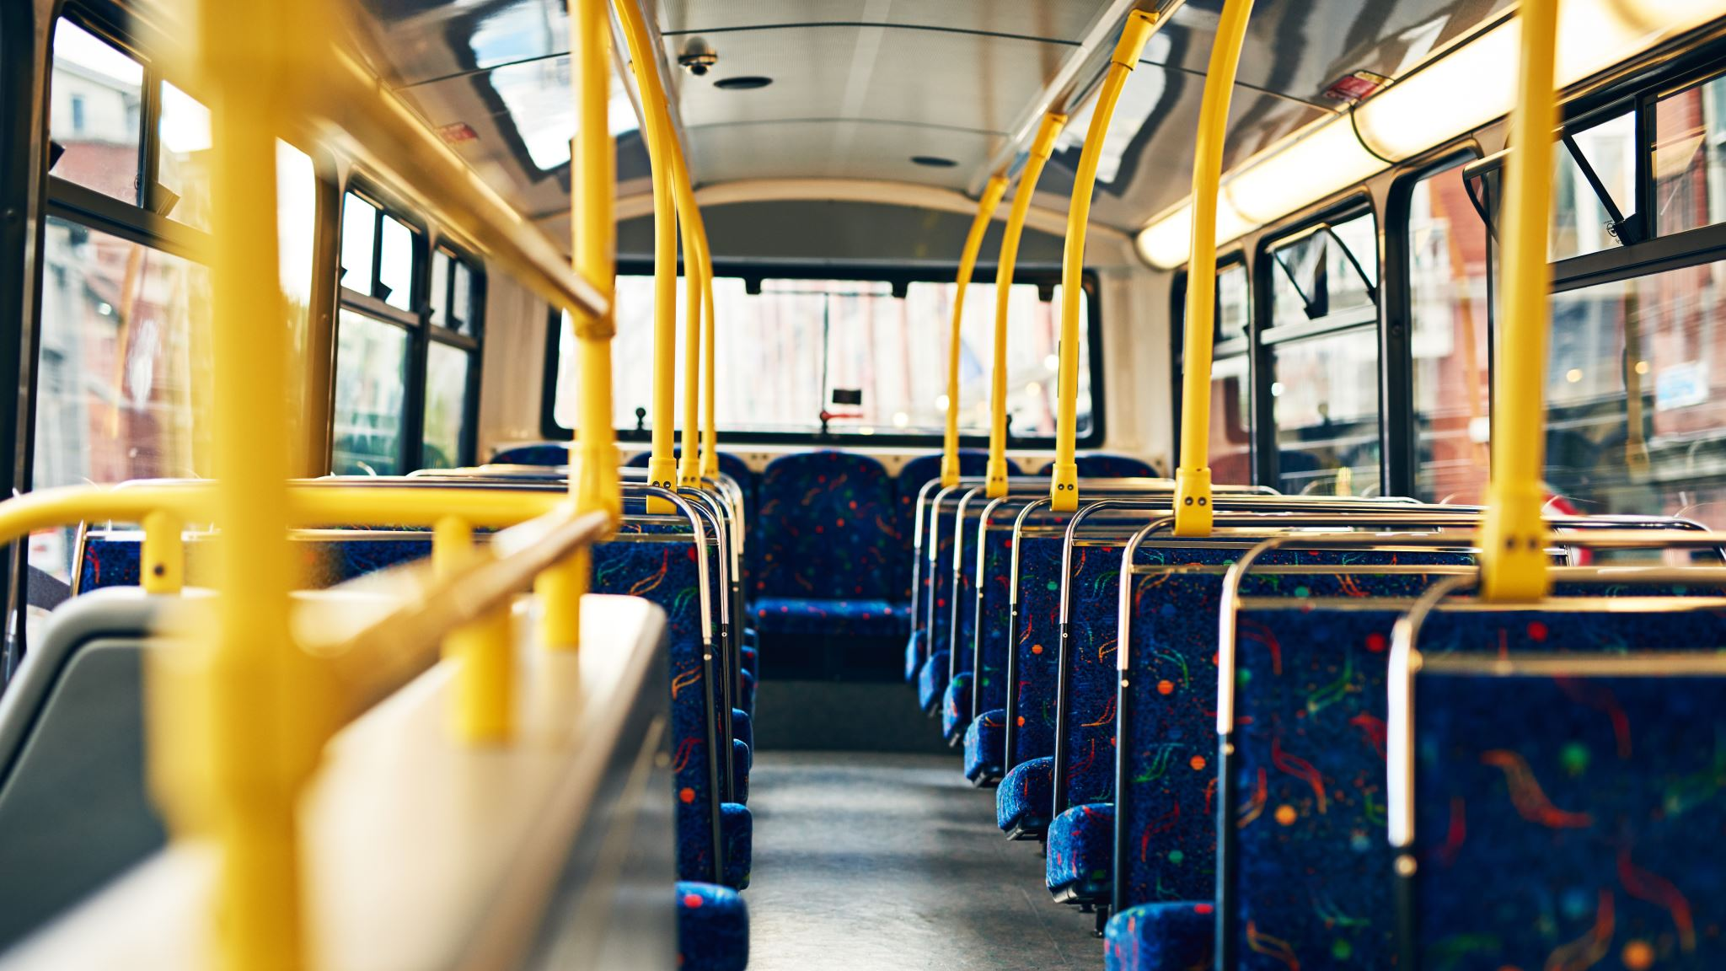
Bus Ticket Booking System
CS5200 Final Project
- By Shivani Sharma and Ananya Asthana

Slide 2
Project Proposal
A system that facilitates the booking of bus tickets, including the management of the bus ticket provider as well as the customer portal, using an interactive CLI based UI that takes in user inputs and provides options to perform tasks based on their roles.
Roles: Admin and Customer
Functions:
Admin – Admin can perform CRUD operations on cities, bus types, drivers and existing trip routes. They can manage trip logistics.
Customer – Customer can perform CRUD operations related to booking their journey and making payments.
Database: bus_ticket_booking

Slide 3
Tables:
bus_journey_booking – Contains details of the seats booked, source and destination route chosen chosen, payment details and the username of the customer who made the booking.
bus_route – The available routes our platform currently provides buses on. Is linked with the bus type and driver.
bus_type – The types of buses available.
user – stores the unique username and role of every user.
5. city – The cities available for trips, that are used in our routes.
6. driver - stores the driver details
7. admin – stores the admin details
8. customer – stores the customer details

Slide 4
Tech Stack :
Java programming language for backend code
MySQL database and workbench for database management
Java Database Connectivity (JDBC) API for connectivity to the MySQL database
JetBrains DataGrip for Database Visualisation

Slide 5
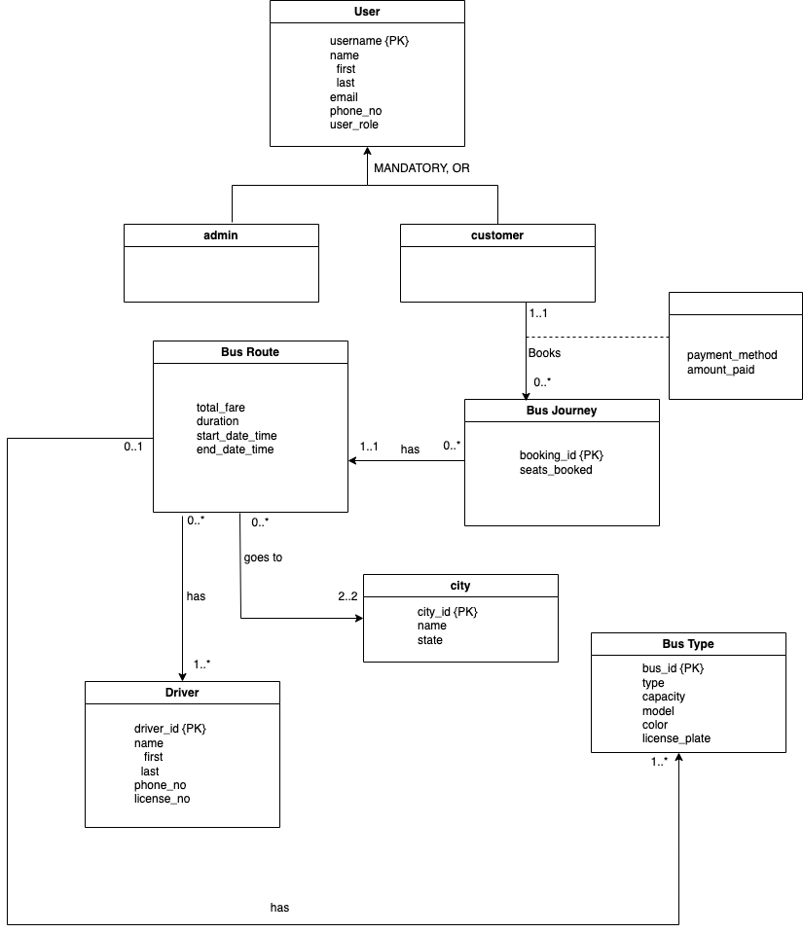
UML Diagram

Slide 6
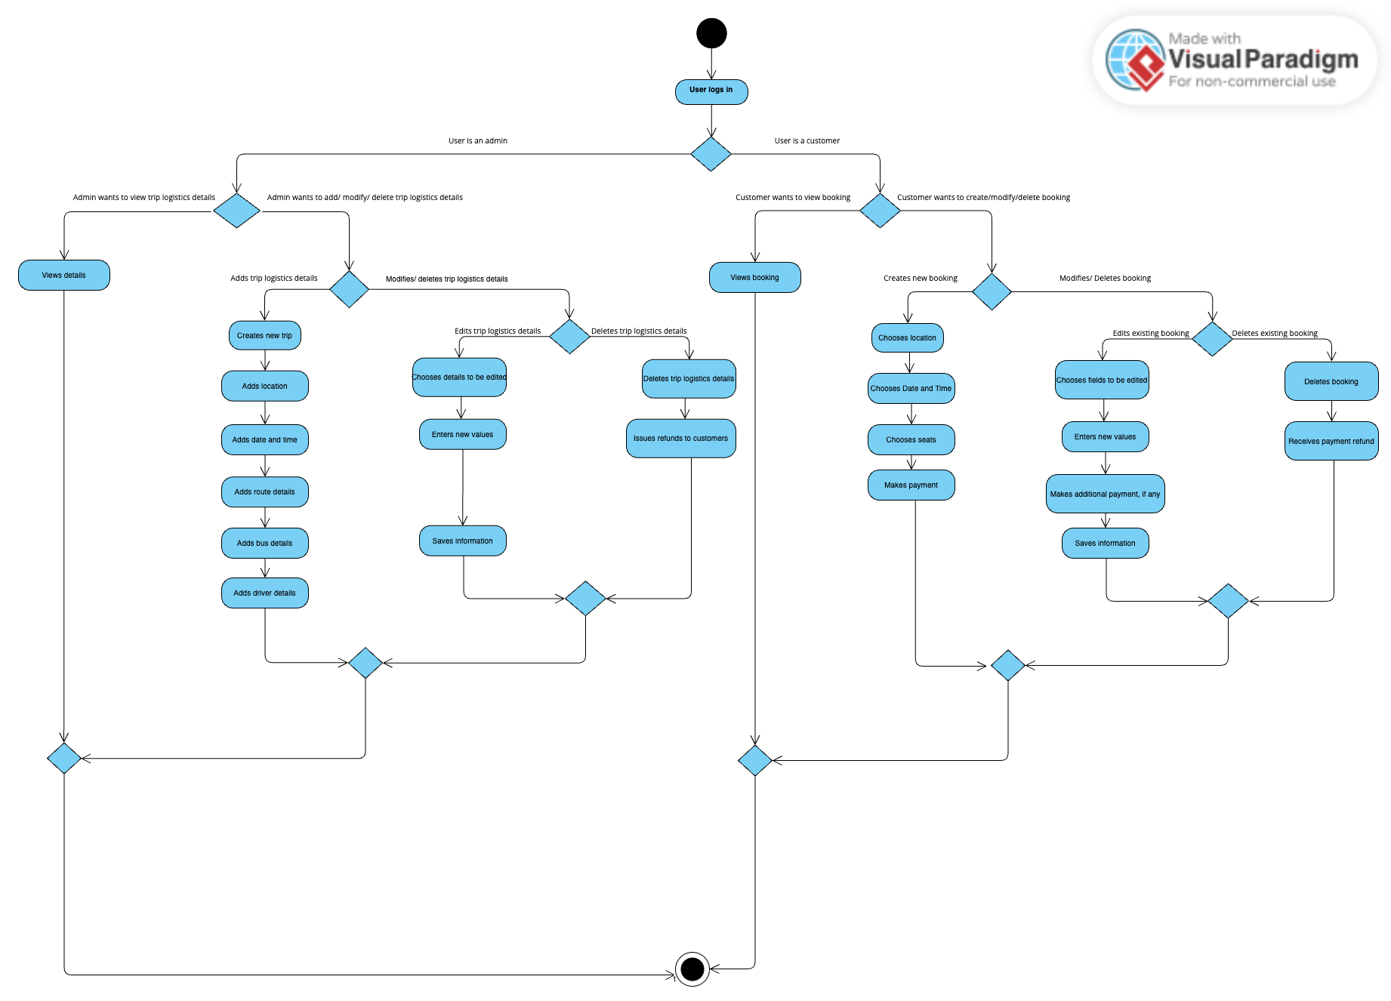
Activity Diagram

Slide 7
CLI DEMO

